Slide 1

A Weight Distance Metric on Categorical Data
温杰
2017.6.28

Slide 2
一、背景

Slide 3
二、缺点

Slide 4
三、带权的耦合属性相似度分析
(W-IaADV) The weight intra-coupled attribute distance for values within an attribute
(W-IeADV) The weighted inter-coupled attribute distance for values with other attribute
coupling intergration on the object level

Slide 5
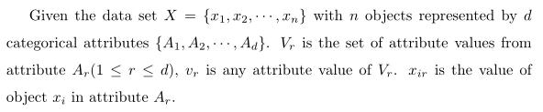
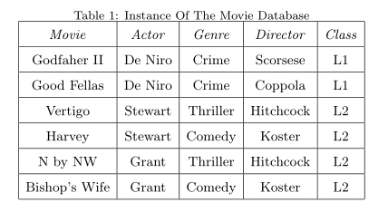
3.1 Preliminary Definitions

Slide 6
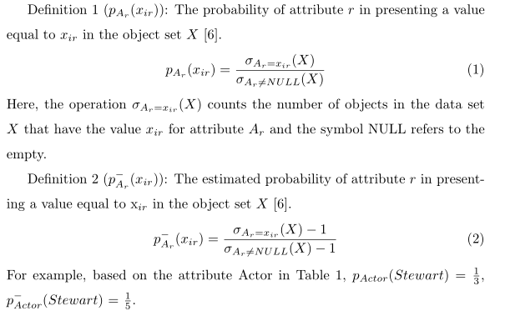
3.2 The Intra-attribute weight

Slide 7
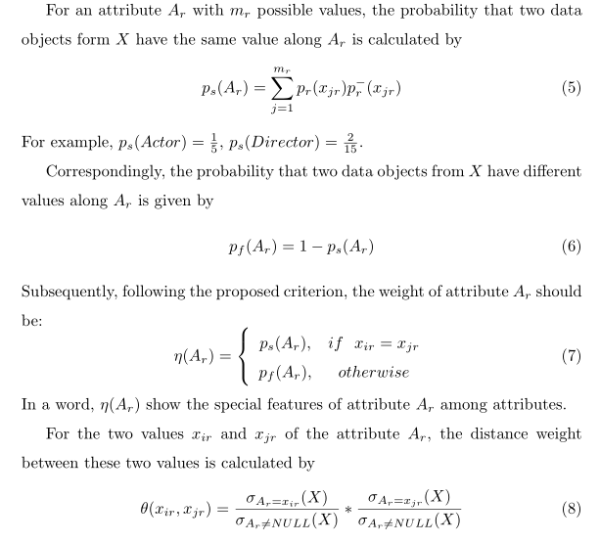

Slide 8
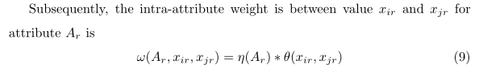

Slide 9
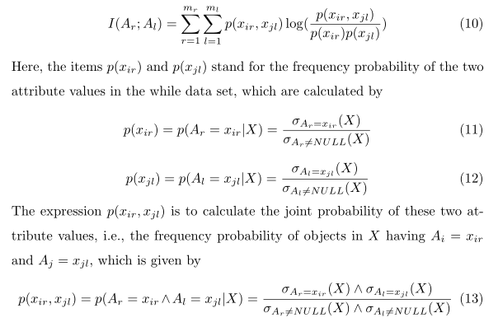
3.2 The Inter-attribute weight

Slide 10
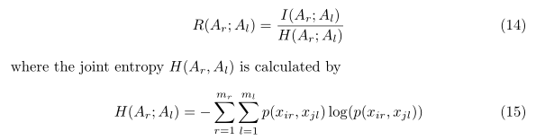


Slide 11
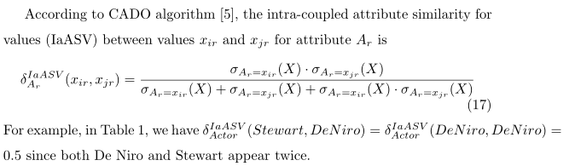
3.3 The weight Inter-attribute measure
Definition IaASV:

Slide 12

Definition W-IaADV: The weight intra-coupled attribute similarity for values between values and of attribute A_{r} is

Slide 13
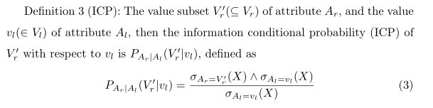

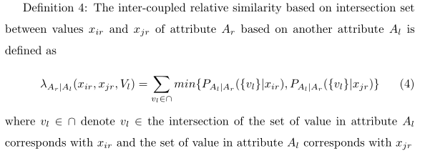
3.4 The weight Inter-Coupled Measure

Slide 14
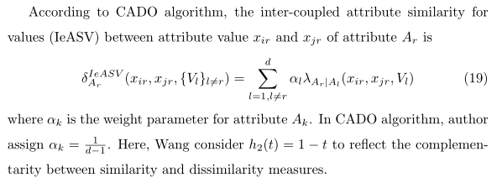

Definition IeASV:
Definition W-IeADV:

Slide 15



Slide 16
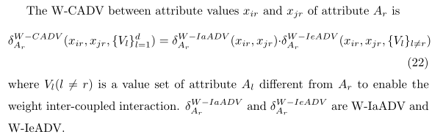
3.5 Coupling Integration

Slide 17


3.6 Example illustrate
They correspond to the fact that the distance between Good Fellas's De Niro and Vertigo's Stewart is larger than that between Godfather II's De Niro and Good Fellas's De Niro.

Slide 18
3.7 Co-Occurence

Slide 19
